Slide 1

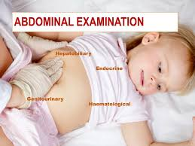
University of Basrah College of Nursing
Pediatric nursing
Abdominal examination
Prepared by:- assist lect. Noor salah shreef

Slide 2
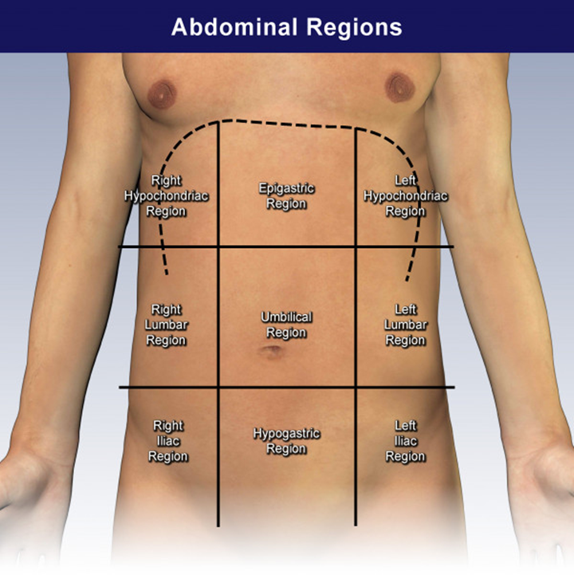

Slide 3
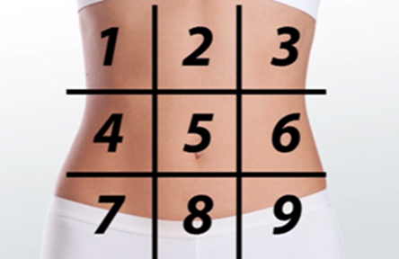
Abdominal examination
In order to do abdominal examination, we have to take the permission from the parents (next of kin), and we put the patient in supine position and we expose the patient gently from the nipple to the mid-thigh, because some of abdominal organs lies below the rib cage e.g., liver, spleen. And the external genitalia are part of the abdomen.

Slide 4
Inspection
(Usually to the patient’s right hand):
1- We mention the symmetry and shape of the abdomen
Usually the abdomen is symmetrical, cylindrical and flat.
Asymmetry may be caused by organomegaly like hepatomegaly or splenomegaly or because of the presence of an abdominal mass like large hernia.

Slide 5
2- The shape of the abdomen may be one of the followings:-
Flat , this is the normal shape.
Scaphoid e.g., like in cachexia, malnutrition in starvation.
Distended abdomen as in the:
Fluid= ascitis
Flatus=intestinal obstruction
Faeces= faecal impaction, constipation.
Abdominal and pelvic tumors, or mass.

Slide 6
3- then we look for:
Epigastric pulsation
Visible peristalsis
Movement of the abdomen with respiration
Any visible mass

Slide 7
Epigastric pulsations: -
It is normally seen in thin individuals and we have to examine or inspect the abdomen for one minute whiles the patient holding his breathing. It is abnormally seen in cases of RVH right ventricular hypertrophy, and when there is a mass overlying the stomach or the aorta.

Slide 8
Visible peristalsis
Usually the peristalsis seen when there is pyloric obstruction and gastric outlet obstruction and we should inspect the abdomen for about 2minutes.
Movement with respiration:-
The abdomen is normally moves with respiration and it is not moving in case of peritonitis. and abdominal movement with respiration becomes more obvious in case of emphysema.

Slide 9
3-inspection from the side of the bed:-
Always we stand to the right side of the abdomen and we look to the followings: - skin, umbilicus and the hernia orifices.
Skin: - we look for scars, discolorations, visible distended veins.
Umbilicus: - we look for the site, shape and abnormal discharge.
Site: - normally the umbilicus located midway between the xiphisternum and the pubic symphysis (centrally located umbilicus).
Shifted umbilicus either upwards as in cases of pelvic tumors and downwards shift as in ascitis and upper abdominal tumors, or mass.
Shape: the umbilicus either flat (normal) , everted (umbilical hernia, abdominal distention) or inverted (infection).
Abnormal discharge:
We have to mention the amount, color and the types of the Discharge as follows:
Faeces, Urine, Blood as in adenoma, Pus in cases of infection.

Slide 10
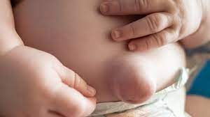

Slide 11
Palpation
1- The hand placed horizontal with wrist and parallel to the patient.
We use the palmer aspect of the fingers for superficial palpation and the tips of the fingers for the deep palpation, the hand should be warm.
2 -the approach we start palpating away from the site of pain which we know from the history or by asking the patient, if he is older child.
If no pain we start from anywhere to finish our palpation at the umbilicus. And always we look to the patient face during palpation.

Slide 12
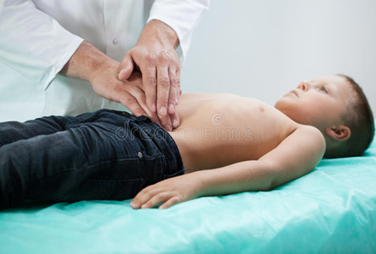
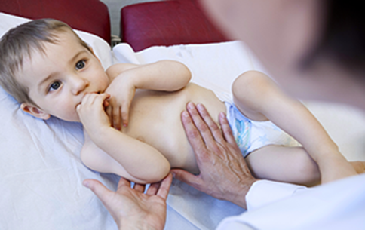
3- if the patient fails to relax his abdomen we do the followings:
A- ask the patient to breath from his mouth.
B- flex the knee joint.
Steps:
The superficial palpation and deep palpation for any tenderness, state of the abdomen and any palpable mass, and organomegaly.

Slide 13
Physical signs:
Rigidity: - continues abdominal contraction.
Gaurdening:- muscular contraction on palpation of an area of tenderness.
Rebound tenderness: - sudden withdrawal of manual pressure leads to snap which exacerbate underlying inflamed organs and the patient will feel pain.
Pointing test: - ask the patient to point to site of maximum tenderness.

Slide 14
Percussion:- we put our hand flat over the abdomen and we tap the middle finger of the placed hand by the middle finger of the other hand usually the abdomen give tympanic percussion sound, unless we have fluid or organomegaly which give dull percussion sound.

Slide 15
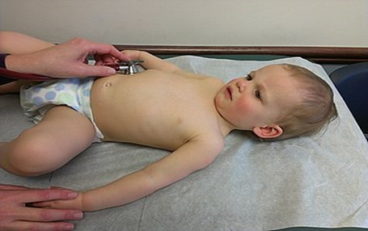
Auscultation:-
We search for bowel sound and vascular bruit:
Techniques: we put the stethoscope for about 2 minute at the right iliac fossa and we hear the peristaltic sound which is noisy gurgling sounds due to the fluid and gases. Absence of the bowel sound is seen in cases of paralytic ileus and exaggerated in cases of mal absorption, mechanical bowel obstruction.
For vascular bruit we put the stethoscope at the following areas:-
Epigastric region
Over the liver
In both loin
Both iliac fosae

Slide 16
Examination of abdominal organs:-
Liver: - in liver examination we need to do palpation, percussion and auscultation.
Palpation: palpation of the liver start from right iliac fossa downward to the right hypochondrium. Ask the patient to take deep breathing and dip your fingers tip gently into the abdomen with each inspiration as the liver is pushed by the movement of the diaphragm.
Percussion: we start the percussion from above at the right second intercostals space until the percussion note change from resonant( which is the percussion of the lung) to dull percussion note( the percussion of the liver). Then we start percussion from the right iliac fossa (bowel percussion note) to the dull percussion note of the liver.
We measure the liver span that is normally between 10-12 cm. in small child about 6-8 cm.

Slide 17
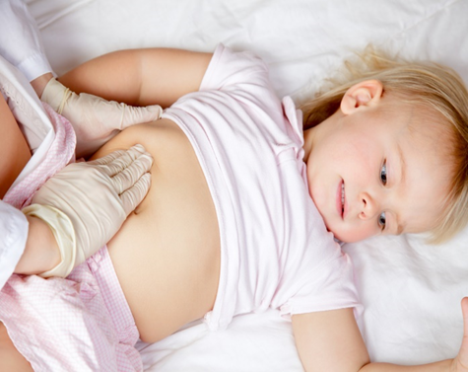
Normally the upper limit of the liver is at 5th intercostals space, and the lower edge of the liver is just palpable below the costal margin.
Auscultation: is important in case of hepatoma (vascular tumour) in which we hear bruit.

Slide 18
Examination of the spleen:
The spleen is the largest lymphoid organs, lies under the diaphragm on the left side of the abdomen, and lies beneath the 9th to 11th ribs.
Palpation: we start palpating from the right iliac fossa towards the left hypochondrium meanwhile we ask the patient to take deep breathing from his mouth and we look to the patient face for any tenderness. The spleen needs to be enlarge 1.5 times to be palpated i.e., the spleen may be enlarged but still impalpable.
Percussion: - if we don’t find palpable spleen we do percussion.

Slide 19
Kidney: the kidneys examined by different methods of palpation.
Bimanual examination: by this way of palpation we put the left hand posteriorly on the renal angle or the costo -vertebral angle which lies between the lower border of the 12 rib and the lateral boarder of the sacrospinalis muscle.
The right hand placed on the flank and we approximate both hands while the patient is breathing

Slide 20
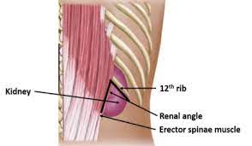

Slide 21
Renal ballottement:- in this way of examination each kidney examined from its side( the right from the right side and the left from the left side) we place the right hand as a watching hand over the right flank while the left hand is the displacing hand is placed over the renal angle. We displace the enlarged kidney by the displacing hand to be felt by the watching hand.

Slide 22
Urinary bladder:-
The urinary bladder examined by palpation and percussion:
Palpation:-We use the ulnar side of the hand from umbilical level downward.
Percussion:-full bladder gives a percussion note.

Slide 23
Examination for free fluid (ascites) in the abdomen:-
Ascites can be examined by two methods shifting dullness and transmitted thrill.
Shifting dullness: - is used when the amount of the fluid is small (500ml)
We start percussion from the midline at the level of the umbilicus till we reach a point of dullness. We fix our hand at that site, then we ask the patient to move slightly to the opposite side and we should wait for about 30-60 sec (to give time for fluid to re accumulate) then percuss backward we will see change in the percussion note from tympanic to dull percussion note so we call it shifting dullness.

Slide 24
Transmitted thrill:-is used when the amount of the fluid is large more than 1000 ml. We place one hand on one side of the abdomen and we tap the abdomen by the other hand on the opposite side so we can feel the transmitted thrill on the other side like a mechanical wave.

Slide 25
In order to finish the abdominal examination we have to examine:-
-The external genitalia.
-Examination of the inguinal lymph nodes.
-Examination of the back.
-Examination of the supraclavicular lymph nodes.

Slide 26


